Slide 1
Managing site settings using add-in model
Name
Title
Company

Slide 2
Agenda
JavaScript Embedding
Introduction
Page and content modifications
Controlling site settings using CSOM

Slide 4
Recommendations
Use JavaScript embedding carefully
Dynamic loading of scripts for JS embedding
Remember client side optimization
Follow up on the CSOM updates
Notes:
Vesa

Slide 5
Introduction

Slide 6
From feature framework to app model
Notes:
Vesa

Slide 7

Site management
Remote APIs
Control site settings using remote APIs like CSOM and REST
Site management performed by code running out side of the SharePoint generally during site provisioning or when apps are added
JavaScript embedding
Apply changes to the pages using JavaScript embedding technique
Can be used to add elements and structures to existing pages
Notes:
Vesa

Slide 8
Page and content modification

Slide 9

Introduction wiki page modification
What
Modify content in wiki pages (site pages library) from SP App by adding html elements or additional web parts.
Why
Modify end user experience automatically on the host web when app is installed or when the sites are provisioned.
How
Access host web using CSOM and add needed html or modify the web parts in the page.

Slide 10
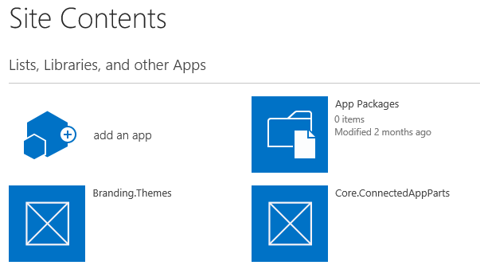
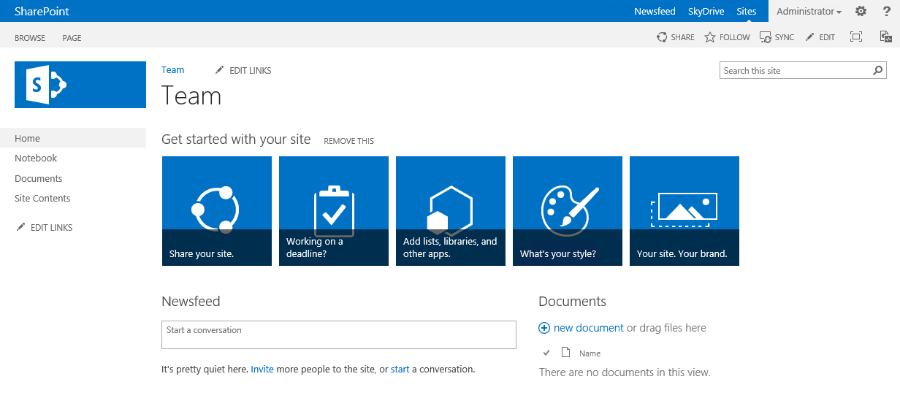
Modify host web content
Handle App Installed event in provider hosted app or apply settings during provisioning
Access host web using client side object model to modify the end user experience
Execution of the needed modifications based on needed event. Can be done based on app installed, part of provisioning or based on end user request
1
SharePoint Service
Provider Hosted Apps
CSOM / REST
2

Slide 11
Page Manipulation
Demo
https://github.com/OfficeDev/PnP/tree/master/Scenarios/Provisioning.Pages

Slide 12
JavaScript Embedding

Slide 13
JavaScript Embedding
What
Apply needed customizations to host web by adding JavaScript to site custom user actions collection, which will modify page rendering when site is used.
Why
Can be used to show new elements or hide existing functionalities from the site without custom master pages or full trust code.
How
Apply needed custom user action to host web during site provisioning or later in the life cycle to change end user experience.

Slide 14
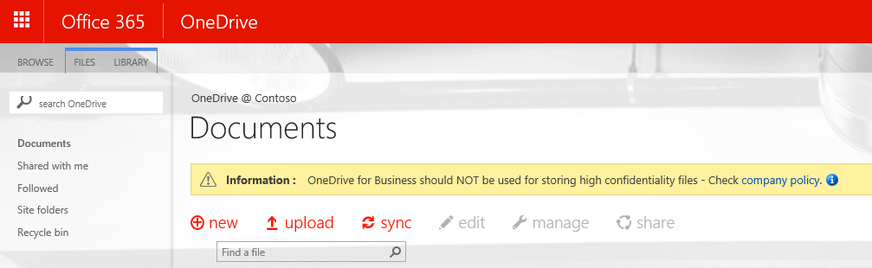
JavaScript embedding for messages
Association of JavaScript Embedding (user custom action) to the site, so that code is executed during site processing
SharePoint Service
1
Provider Hosted Apps
CSOM / REST
2
<<Reference>>
js
3
UX elements are rendered with JavaScript by using with script stored either in SharePoint, centrally in the provider hosted app side or in some CDN. Preferable in one location for easy update cross all instances.

Slide 15
“Wouldn’t this cause dependency on page dom structure, so any change can break it?”
Yes
Similarly as element changes in the pages can break custom CSS, they could break JS embedding. You should use one JS embedding file cross all sites for easier fix if changes are happening. This should not however happen frequently.
Notes:
Vesa

Slide 16
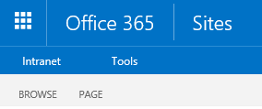
JS proxy refresh model
SharePoint Service
Dynamically load the right script based on current status. Could be indicated from SP list, site property bag or by any other means.
Provider Hosted Apps
js
<<Reference>>
<< load dynamically >>
JS logic v1
1
js
<script>
<< load dynamically >>
Used JavaScript in the SharePoint site is referenced from some centralized location (root site collect, provider hosted app, CDN), but it does only works as a dynamic loading router and does not have have actual business code.
”Proxy JS”
2
js
<< load dynamically >>
JS logic v2
js
JS logic v3

Slide 17
JavaScript Embedding
Demo
https://github.com/OfficeDev/PnP/tree/master/Samples/Core.EmbedJavaScript

Slide 18
Controlling site settings

Slide 19
Controlling site settings
What
Control site administrative settings to apply needed configuration for the end users. Could be for example site language settings or regional settings.
Why
Automate site configuration for the end users with needed settings.
How
Apply settings during site provisioning or when apps are installed based on the business scenario.

Slide 20
Typical settings controlled in site level
Feature management
Activation or deactivation
Permission management
SharePoint Designer settings
Site logo
Auditing settings*
Regional settings*
Time Zone settings*
Language settings*
Audit settings*
* Released partly in 2014 December CU for on-premises

Slide 21
“Are we getting more site level APIs for CSOM and REST?”
Depends
Please use Office Dev user voice for providing your input on the needed capabilities. CSOM will never be as rich as what server side object model was, but we will keep on adding capabilities as needed based on your input.
Notes:
Vesa

Slide 22
Performance optimization

Slide 23
Caching and asset optimization
What
Like with server side code, caching is important when client side implementations are used to ensure proper end user experience.
Why
Make sure that user interface is efficiently updated and there is not visible impact on using client side techniques.
How
Use cookies and HTML local store capabilities efficiently to cache the relevant information and update information only as needed using async techniques.
Load files dynamically from one location using bootstraps which will help on providing updates as well.
Notes:
Vesa
NOTE: Remember that client side caching can be VERY helpful for bandwidth reductions… and performance optimizations.
Caching Examples located here: https://github.com/OfficeDev/PnP/tree/master/Samples/Performance.Caching

Slide 24


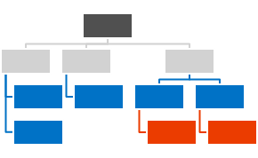
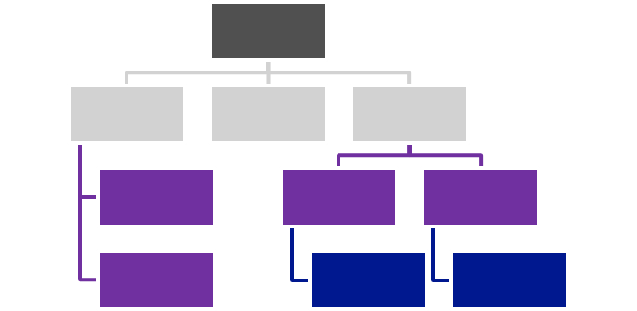



Centralized Asset Deployment
https://Contoso.sharepoint.com /sites/site
https://Contoso.sharepoint.com
<<Reference>>
https://Contoso.sharepoint.com /sites/site2
<<Reference>>
<<Reference>>
<<Reference>>
Provider Hosted Apps
<<Reference>>
https://Contoso.sharepoint.com /sites/site3
<<Reference>>
Notes:
Static assets like images, JS files, and CSS files are deployed together with the master page and asp files to the root site collection of the a web application or a tenant.
Dynamic files like master pages and other asp pages are deployed to the each site collections.
Static files are referenced from the root site collection using relative links.
Provides one location to change most of the functionalities and there’s no need to deploy all the image, CSS, or JS files to each of the site collection.

Slide 25
“Can I use Content Delivery Networks for asset storage?”
Yes.
You can store majority of the files in some CDN service. There are however some elements which will have to be present in each site collection.
Notes:
Vesa
NOTE: Any element that requires service side processing (ie Master Pages, Page Layouts, etc need to be resident in the site collection. )
Javascript refernces must INITITATE from the site for the most part – you can dynamically load external JS but the initital JS file has to be located in the site.

Slide 26
Caching with client side techniques
Demo
https://github.com/OfficeDev/PnP/tree/master/Samples/Performance.Caching

Slide 27
Recommendations
Use JavaScript embedding carefully
Dynamic loading of scripts for JS embedding
Remember client side optimization
Follow up on the CSOM updates
Notes:
Vesa

Slide 28
Questions?

Slide 29

Sharing is caring…
Reusable code samples
Guidance documentation
Monthly community calls
Case Studies
SharePoint Framework
SharePoint add-ins
Microsoft Graph
Remote API access
http://aka.ms/SharePointPnP

Slide 30


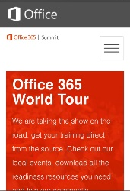
dev.office.com
Sign up
http://dev.office.com/getting-started
Explore
http://apisandbox.msdn.microsoft.com
Get trained http://dev.office.com/training

Slide 31


Feedback
Office 365 Network Share you best practices and join conversations
https://www.yammer.com/itpronetwork
Stackoverflow Ask deep technical questions to a world-wide set of developers
http://stackoverflow.com/questions/tagged/ms-office
UserVoice Provide suggestions of what you want in future versions
http://officespdev.uservoice.com/

Slide 32


© 2015 Microsoft Corporation. All rights reserved. Microsoft, Windows, and other product names are or may be registered trademarks and/or trademarks in the U.S. and/or other countries.
The information herein is for informational purposes only and represents the current view of Microsoft Corporation as of the date of this presentation. Because Microsoft must respond to changing market conditions, it should not be interpreted to be a commitment on the part of Microsoft, and Microsoft cannot guarantee the accuracy of any information provided after the date of this presentation. MICROSOFT MAKES NO WARRANTIES, EXPRESS, IMPLIED OR STATUTORY, AS TO THE INFORMATION IN THIS PRESENTATION.

